Slide 1
10
Making Capital Investment Decisions

Slide 2

Chapter 10 – Index of Sample Problems
Slide # 03 - 04 Relevant costs
Slide # 05 - 06 Relevant cash flows
Slide # 07 - 08 Net working capital
Slide # 09 - 12 MACRS depreciation
Slide # 13 - 16 After-tax salvage value
Slide # 17 - 20 Pro forma income statement
Slide # 21 - 22 Project operating cash flow
Slide # 23 - 25 Project net present value
(Continued on the next slide)

Slide 3
Chapter 10 – Index of Sample Problems
Slide # 26 - 27 Bottom-up OCF
Slide # 28 - 29 Top-down OCF
Slide # 30 - 31 Tax-shield OCF
Slide # 32 - 33 Cost-cutting projects
Slide # 34 - 37 Bid price
Slide # 38 - 40 Equivalent annual cost

Slide 4
3: Relevant costs
Three years ago, the Jamestown Co. purchased some land for $1.24 million. Today, the land is valued at $1.32 million. Six years ago, the company purchased some equipment for $189,000. This equipment has a current book value of zero and a current market value of $39,900.
What value should be assigned to the land and the equipment if the Jamestown Co. opts to use both for a new project?

Slide 5
4: Relevant costs
Relevant cost = $1,320,000 + $39,900
= $1,359,900

Slide 6
5: Relevant cash flows
The Blue Shoe currently sells 13,000 pairs of athletic shoes and 4,500 pairs of dress shoes every year. The athletic shoes sell for an average price of $79 a pair while the average price for the dress shoes is $49. The company is considering expanding their offerings to include sandals at an average price of $29 a pair. The Blue Shoe estimates that the addition of sandals to their lineup will reduce their dress shoe sales by 1,000 pairs and increase their athletic shoes sales by 800 pairs. The Blue Shoe expects to sell 4,500 pairs of sandals if they decide to carry them.
What amount should the Blue Shoe use as the annual estimated sales revenue when they analyze the addition of sandals to their lineup?

Slide 7
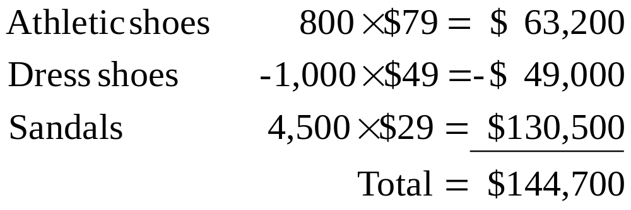
6: Relevant cash flows

Slide 8
7: Net working capital
The Fritz Co. is considering a new project and asked the chief accountant to review potential changes to the net working capital accounts should the project be adopted. The accountant’s report is as follows:
Current Projected Accounts receivable $ 89,430 $110,000
Inventory $ 99,218 $ 75,000
Accounts payable $ 58,640 $ 50,000
What amount should be included in the initial cash flow of the project for net working capital?

Slide 9
8: Net working capital
Current Projected Cash flow
Accounts receivable $ 89,430 $110,000 -$20,570
Inventory $ 99,218 $ 75,000 $24,218
Accounts payable $ 58,640 $ 50,000 -$ 8,640
Total -$ 4,992

Slide 10
9: MACRS depreciation
Year | 5-year
1 | 20.00%
2 | 32.00%
3 | 19.20%
4 | 11.52%
5 | 11.52%
6 | 5.76%
Williamson Industries purchased some 5-year property at a cost of $264,900.
What is the depreciation expense for year 2?
What is the depreciation expense for year 4?

Slide 11
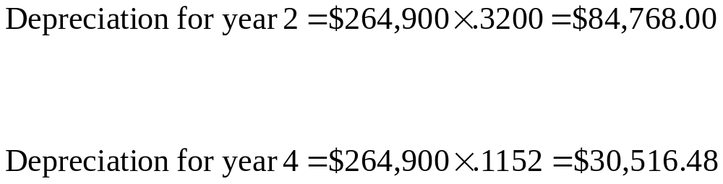
10: MACRS depreciation

Slide 12
11: MACRS depreciation
Year | 5-year
1 | 20.00%
2 | 32.00%
3 | 19.20%
4 | 11.52%
5 | 11.52%
6 | 5.76%
Appleton’s, Inc. purchased equipment which is classified as 5-year property for MACRS. The equipment cost $178,400.
What is the book value of the equipment at the end of the first year?
What is the book value of the equipment at the end of year four?

Slide 13
12: MACRS depreciation
Book value at end of year one
$178,400 × (1 - .20) = $142,720.00
Book value at end of year four
$178,400 × (1 -.20 - .32 - .192 -.1152) = $30,827.52
Year | 5-year
1 | 20.00%
2 | 32.00%
3 | 19.20%
4 | 11.52%
5 | 11.52%
6 | 5.76%

Slide 14
13: After-tax salvage value
Year | 5-year
1 | 20.00%
2 | 32.00%
3 | 19.20%
4 | 11.52%
5 | 11.52%
6 | 5.76%
The Honey Bee Co. purchased some equipment
three years ago at a cost of $36,500. The equipment is 5-year property for MACRS, which is the depreciation method used by the firm. Today, the company sold that equipment for $18,900.
What is the after-tax salvage value if the applicable tax rate is 34%?

Slide 15
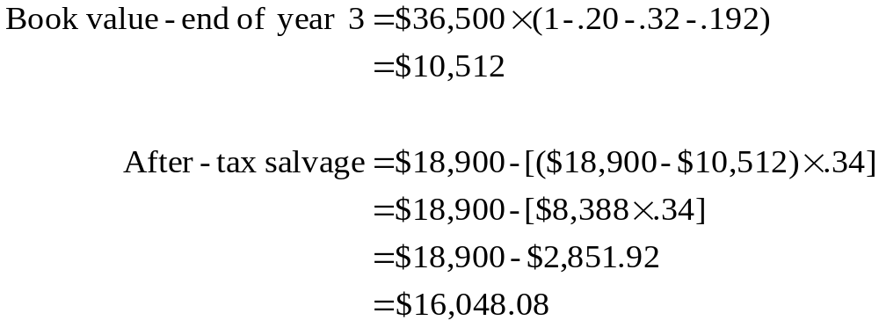

14: After-tax salvage value
Year | 5-year
1 | 20.00%
2 | 32.00%
3 | 19.20%
4 | 11.52%
5 | 11.52%
6 | 5.76%

Slide 16
15: After-tax salvage value
Year | 5-year
1 | 20.00%
2 | 32.00%
3 | 19.20%
4 | 11.52%
5 | 11.52%
6 | 5.76%
Ten years ago, TJ’s purchased some equipment at a cost of $384,900. The equipment was classified as 5-year property for MACRS. Today, the company sold the equipment for $49,000.
What is the after-tax salvage value if the applicable tax rate is 35%?

Slide 17
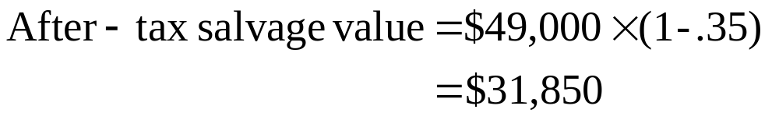
16: After-tax salvage value

Slide 18
17: Pro-forma income statement
A project is expected to generate $48,400 in sales, $31,500 in costs and $7,500 in depreciation expense.
What is the projected net income for this project if the applicable tax rate is 34%?

Slide 19
18: Pro-forma income statement
Sales $48,400
Costs 31,500
Depreciation 7,500
EBIT $ 9,400
Tax (34%) 3,196
Net income $ 6,204

Slide 20
19: Pro-forma income statement
Complete the following income statement:
Sales $______
Costs $679,420
Depreciation $ 94,200
EBIT $______
Taxes (34%) $______
Net income $ 82,566

Slide 21
20: Pro-forma income statement
Sales $898,720 Step 3. $125,100 + $94,200 +$679,420
Costs $679,420
Depreciation $ 94,200
EBIT $125,100 Step 1. $82,566 / (1-.34)
Taxes (34%) $ 42,534 Step 2. $125,100 - $82,566
Net income $ 82,566

Slide 22
21: Project operating cash flow
Betty’s Boutique is considering a project with projected sales of $46,000. Costs are estimated at $29,500. The project will require $20,000 initially for the purchase of new equipment. This equipment will be depreciated using straight line depreciation to a zero book value over the four year life of the project. The equipment will be worthless at the end of the four years. The tax rate is 35%.
What is the amount of the projected annual operating cash flow for this project?

Slide 23
22: Project operating cash flow
Sales $46,000
Costs 29,500
Depreciation 5,000 ($20,000 ÷ 4)
EBIT $11,500
Tax (35%) 4,025
Net income $ 7,475
OCF = EBIT + Depreciation - Taxes
OCF = $11,500 + $5,000 - $4,025 = $12,475

Slide 24
23: Project net present value
Wilson’s is considering a project which will initially require $12,000 for new equipment. The equipment will be depreciated straight line to a zero book value over the three year life of the project. In addition, the project will require $30,000 of net working capital which will be recovered at the end of the project. Annual sales are estimated at $45,000 with costs of $32,400. The equipment has an expected salvage value of $12,000. The tax rate is 34%.
What is the net present value of this project if the required rate of return is 14%?

Slide 25
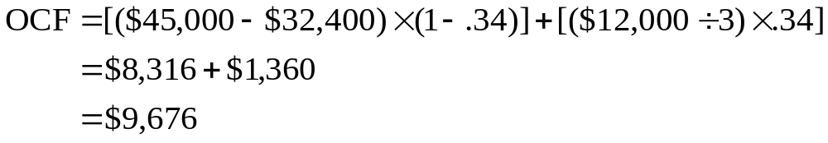
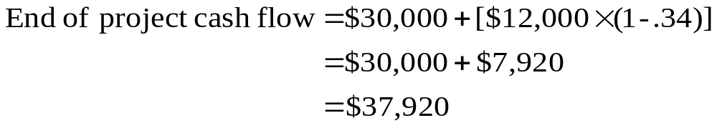
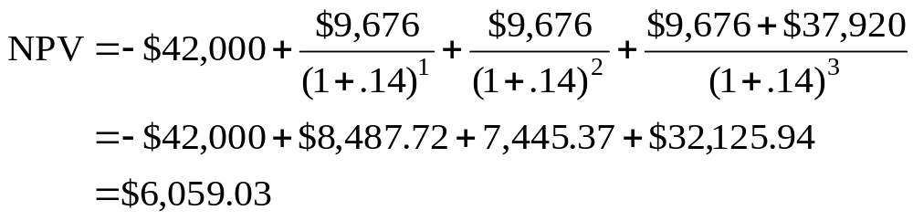
24: Project net present value
Initial cash flow = -$12,000 - $30,000 = -$42,000

Slide 26
25: Project net present value
CF₀ = -$42,000
CO₁ = $ 9,676 FO₁ = 2
CO₂ = $47,596 FO₂ = 1
I = 14%
NPV CPT
$6,059.03
Note: $9,676 + $37,920 = $47,596 for CO₂

Slide 27
26: Bottom-up OCF
Currie’s, Inc. is reviewing a project that is expected to produce a net income of $4,600 each year for three years. The project requires the purchase of $9,000 of equipment which will be depreciated straight line to a zero book value over the three years. The project will be funded by excess cash of the firm. Thus, no debt is required.
What is the projected annual operating cash flow of this project?

Slide 28
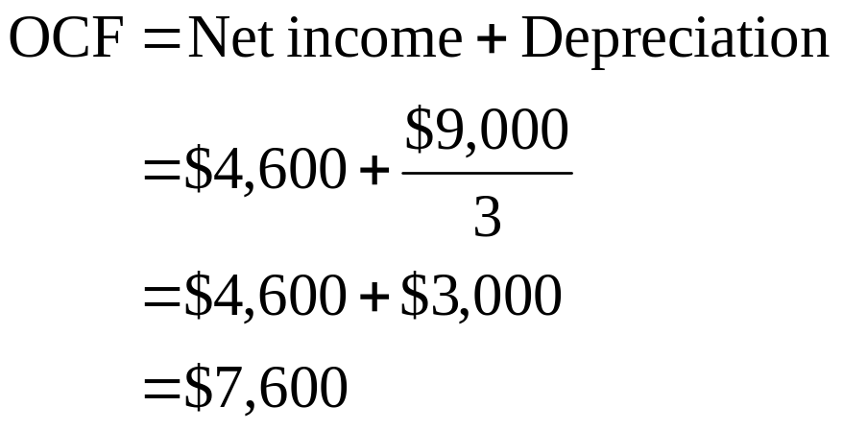
27: Bottom-up OCF

Slide 29
28: Top-down OCF
Meker’s Automotive is reviewing a project that has projected sales of $61,000, costs of $44,800, depreciation of $12,600 and taxes of $2,400.
What is the projected operating cash flow of this project?

Slide 30
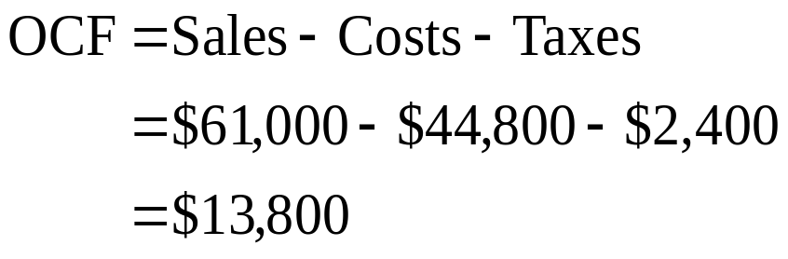
29: Top-down OCF

Slide 31
30: Tax-shield OCF
LaMont, Inc. is analyzing a project that has projected sales of $56,800, costs of $46,700 and annual depreciation of $4,500. The tax rate is 35%.
Use the tax-shield approach to compute the annual operating cash flow for this project.

Slide 32
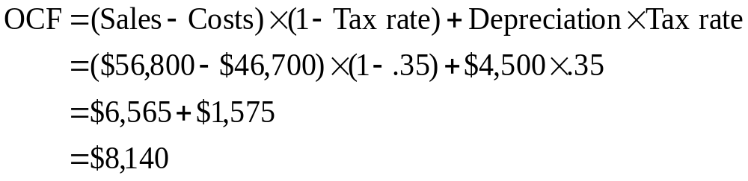
31: Tax-shield OCF

Slide 33
32: Cost-cutting projects
Melvin’s Machine Shop is considering the purchase of an automated machine which costs $480,000. The company would depreciate this machine using straight line depreciation over the six year life of the project. This machine is expected to reduce operating costs by $95,000 a year. The applicable tax rate is 35%.
What is the projected annual operating cash flow for this proposed equipment purchase?

Slide 34
33: Cost-cutting projects
Sales $ 0
Costs -95,000
Depreciation 80,000
EBIT $15,000
Tax (35%) 5,250
Net income $ 9,750
OCF = $15,000 + $80,000 -$5,250
= $89,750

Slide 35
34: Bid price
Your firm wants to place a bid on cabinet hinges. The contract is for 10,000 units per year for three years. You have determined that this project would require $20,000 in net working capital for the life of the project. $30,000 of equipment would be needed. The equipment would be depreciated straight line to a zero book value over the three years. At the end of the project, the equipment will be worthless. Production costs will include $10,500 in fixed costs and $2.04 in variable costs per unit. The tax rate is 34% and the required rate of return is 14%.
How much should you bid per unit?

Slide 36
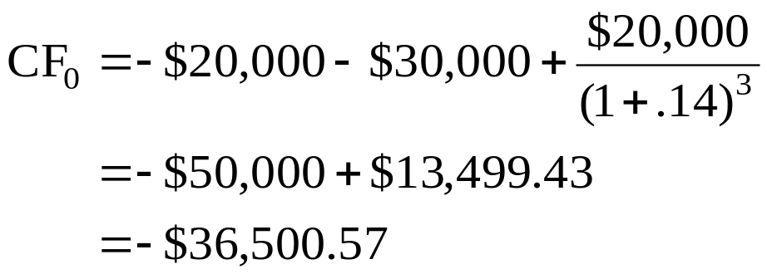
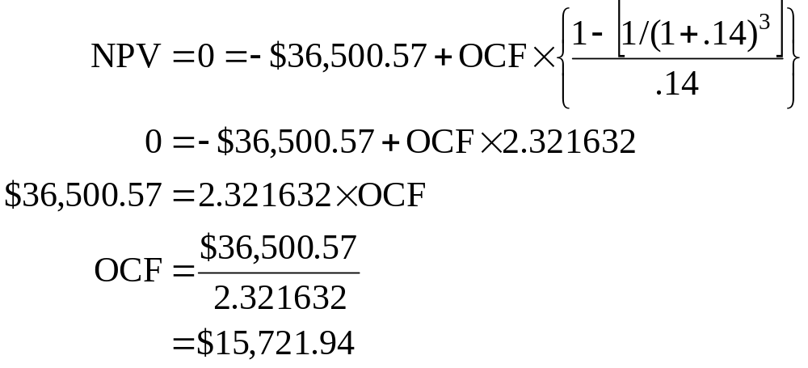
35: Bid price

Slide 37
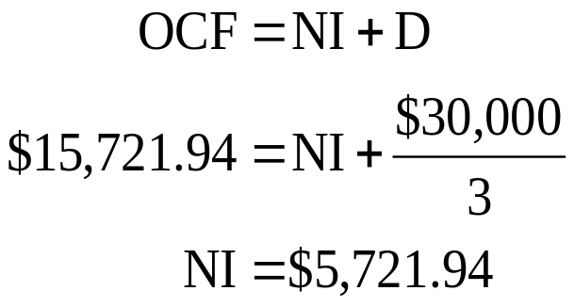
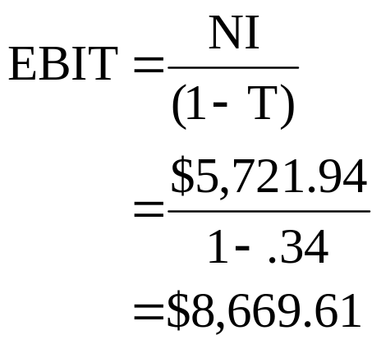
36: Bid price

Slide 38
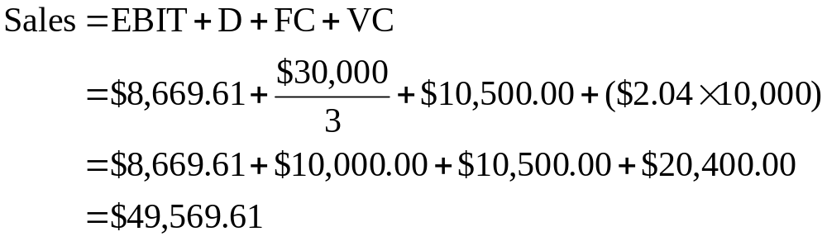
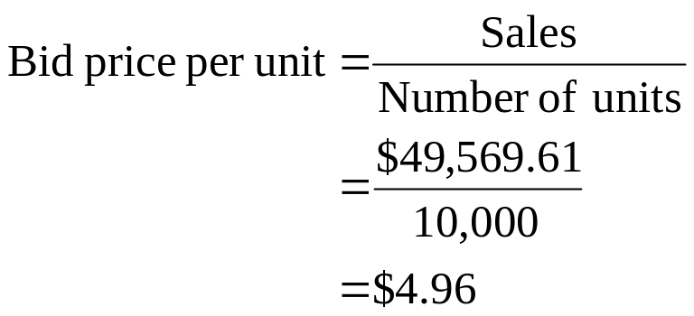
37: Bid price

Slide 39
38: Equivalent annual cost
Allen’s Automation is considering the purchase of a machine costing $84,000. The machine would be depreciated using straight line depreciation to a zero book value over the three year life of the machine. This machine would be worthless at the end of the three years. The machine will be replaced at that time. The estimated cost to operate the machine each year is $8,000. The tax rate is 34%.
What is the equivalent annual cost of this machine if the required rate of return is 12%?

Slide 40
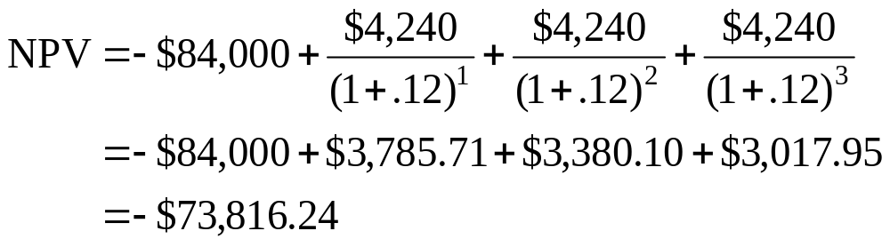
39: Equivalent annual cost
Operating cost $ 8,000
Depreciation 28,000
EBIT -$36,000
Tax (34%) - 12,240
Net income -$23,760
OCF = -$36,000 + $28,000 - (-$12,240)
= $4,240

Slide 41
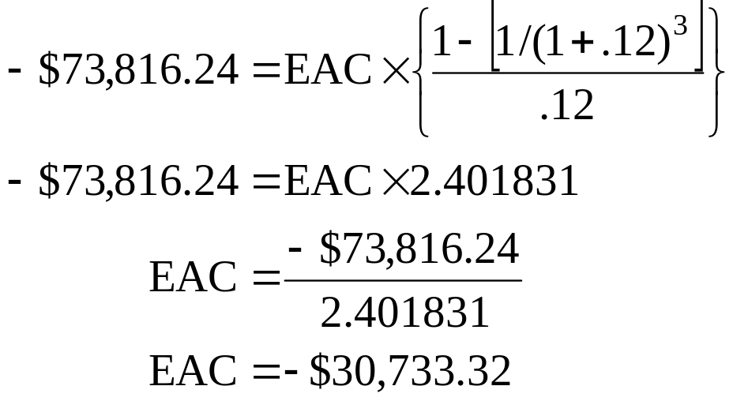
40: Equivalent annual cost

Slide 42
10
End of Chapter 10

